Slide 1
Managing International Business

Slide 2
“If we distributed pictures only in the United States, we’d lose money. It takes the whole world now to make the economics of movie-making work.”
- William Mechanic
President, 20th Century Fox

Slide 3
“Half the people in the world have yet to take their first picture. The opportunity is huge, and it’s nothing fancy. We just have to sell yellow boxes of film.”
- George M.C. Fisher
CEO, Eastman Kodak Co

Slide 4
In 1950, the International Trade was worth $55 billion. From here, it has raised to $10120 billion in 2005.
Germany ranks the first in exports and exported goods worth $912.3 billion with a global share of 10% in 2004. USA ranked second with $818.8 billion and 8.9% share. India was 30th with exports of $75.6 and a share of 0.8%.
In imports, the USA has imported goods worth $1525.5 billion with a global share of 16.1%. India ranks 23rd with imports of $97.3 billion and 1% of the global share.

Slide 5
International Business
International Business is defined as commercial transaction that occurs across country borders.
All commercial transactions including sales, investment, and transportation, that take place between two or more countries.

Slide 6
Nature of International Business
Involvement of commercial activities.
Surrounded with political risk.
Proactive or reactive
Differs from domestic business
Large scale operations
Sensitive nature.
Role of technology

Slide 7

Drivers of International Expansion
Competition
Regional Economic and Political Integration
Technology
Improvements in
Telecommunication and
Transportation
Economic Growth
Transition to Market Economy
Converging Consumer Needs

Slide 8
Drivers of International Expansion, continued
COMPETITION
McCann Erickson, the advertising agency, follows longtime client, Coke, to all countries where company is present

Slide 9
Drivers of International Expansion, continued
REGIONAL, ECONOMIC and POLITICAL INTEGRATION
Regional agreements such as NAFTA, European Union lower and eliminate barriers and promote trade within common markets.
Subsidiaries are established in specific markets to take advantage of free trade within the region.

Slide 10
Drivers of International Expansion, continued
TECHNOLOGY
Consumers worldwide are exposed to similar products, services, and entertainment.
The Web and the Internet have revolutionized the way companies conduct business.

Slide 11
Drivers of International Expansion, continued
TRANSPORTATION and TELECOMMUNICATIONS
Lower cost and higher quality communication due to satellite technology, teleconferencing, and e-mail
Efficient transportation due to containerization and just-in-time technology

Slide 12
Drivers of International Expansion, continued
ECONOMIC GROWTH
Emerging middle class with increasing buying power in big emerging markets such as Brazil and India
Opening of new markets previously closed, such as the markets of China and Vietnam
Emerging economies are becoming viable trade partners

Slide 13
Drivers of International Expansion, continued
TRANSITION to a MARKET ECONOMY
Transition of the Eastern Bloc to a market economy created important new markets
Created opportunities to transform inefficient government-owned local companies into successful enterprises

Slide 14
Drivers of International Expansion, continued
CONVERGING CONSUMER NEEDS
Uniform consumer segments emerging worldwide: global teenagers, global elite

Slide 15
Firm-Specific Drivers
Product Life Cycle Considerations: opportunity to prolong product lifecycle by entering growth markets.
Intro
Growth
Maturity
Decline
Sales
Sales
Profits

Slide 16
Firm-Specific Drivers, continued
High New Product Development Costs:
Firm must look beyond home-country market to recover investment costs

Slide 17
Firm-Specific Drivers, continued
Standardization, Scale Economies, Cheap Labor
Price competition during maturity drives firm to new international markets
Intro
Growth
Maturity
Decline
Sales
Sales
Profits
Time

Slide 18
Firm-Specific Drivers, continued
Experience Transfers
Experience in one country serves as basis for strategies
in new international markets.

Slide 19
In The Fortune at the Bottom of the Pyramid, C.K. Prahalad presents a compelling argument for firms to consider emerging markets not as a society of poor individuals but a 4 billion market opportunity that will not only benefit the firm but even help alleviate poverty. Firms, however, should not make haste assumptions and enter into foreign markets without the proper due diligence of evaluating the market opportunity, modify the product or service to meet the needs of the target market(s), and leverage scale and innovation to create real value

Slide 20
Obstacles to Internationalization
Self-reference Criterion
Conscious and unconscious reference to own national culture while operating in the host country
To counter the impact of the self-reference criterion, the corporation must select appropriate personnel for international assignments and engage in sensitivity training
To overcome this bias, one needs to develop a global awareness that goes beyond identifying cultural difference but tolerance and knowledge of cultures.

Slide 21
Government Barriers
Restrictions placed on foreign corporations by imposing tariffs, import quotas, and other limitations, such as restrictive import license awards

Slide 22
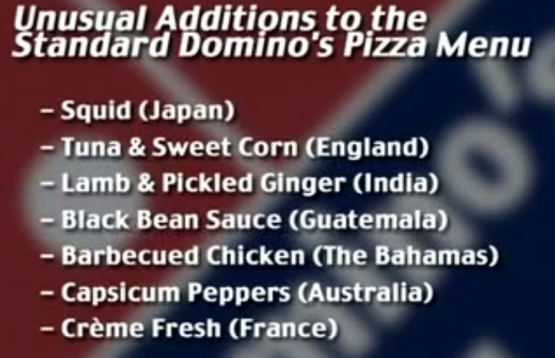

Slide 23
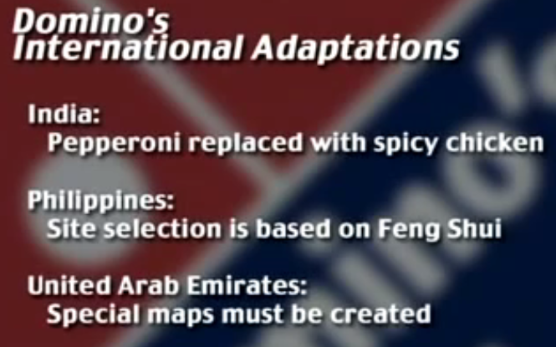

Slide 24
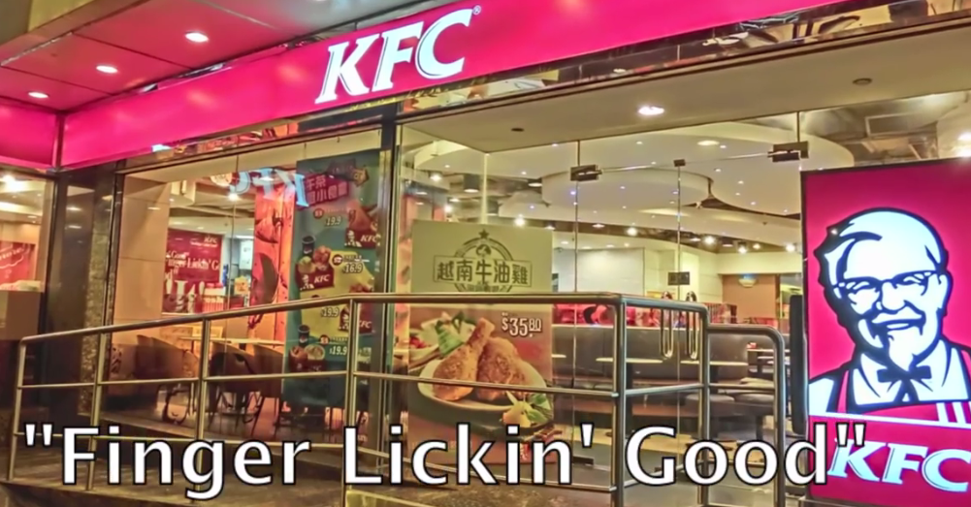
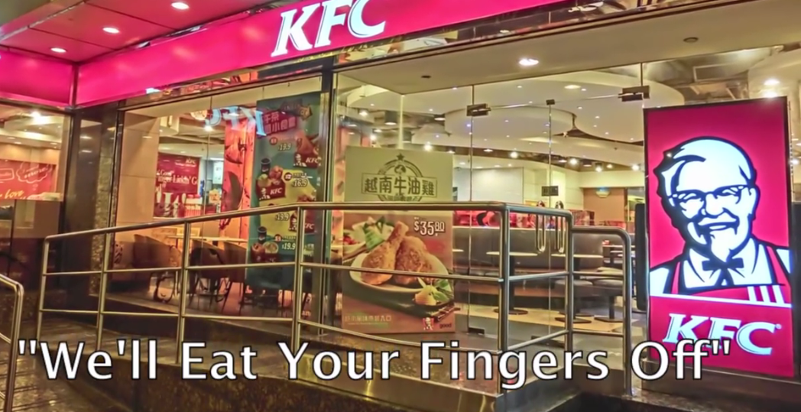
Cultural Differences – Few Examples

Slide 25
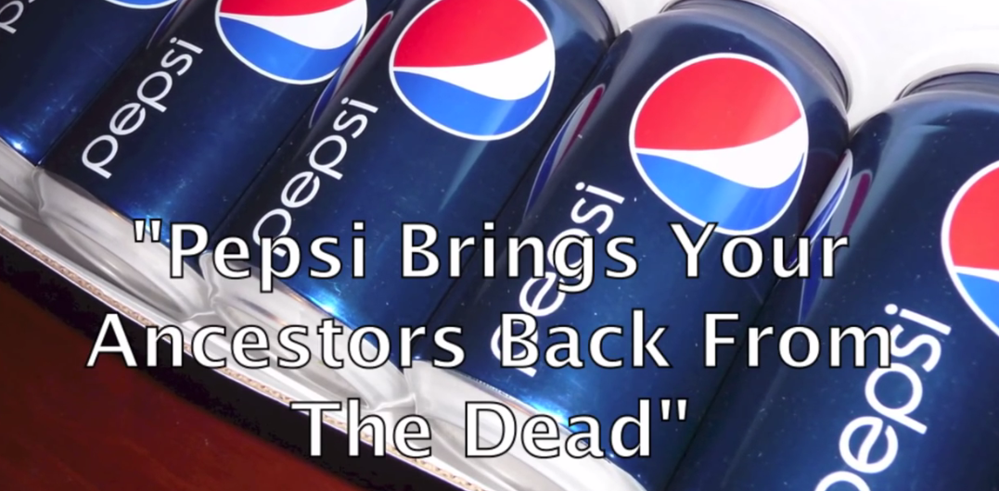


Slide 26



Slide 27

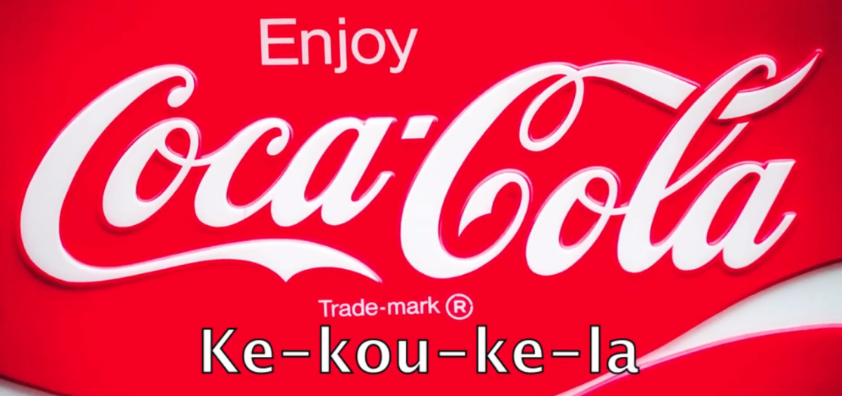

Slide 28
Scanning International Environment
Business environment is a very important determinant of business strategy.
It is the difference in the marketing environment which make the international business strategy different from domestic one.

Slide 29
Environmental Scanning
Environmental scanning is a process of gathering, analyzing, and dispensing information for tactical or strategic purposes. The environmental scanning process entails obtaining both factual and subjective information on the business environments in which a company is operating or considering entering

Slide 30
Environmental scanning usually refers just to the macro environment, but it can also include industry, competitor analysis, marketing research (consumer analysis), new product development (product innovations) or the company's internal

Slide 31
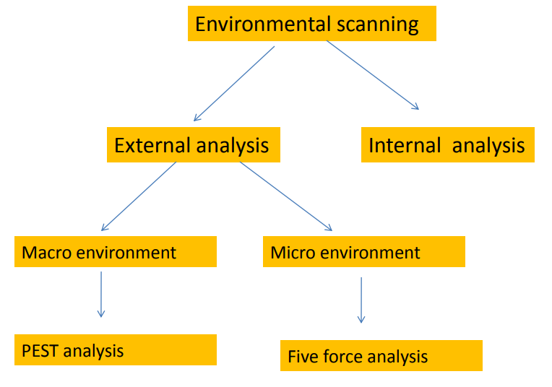

Slide 32
PEST Analysis
Political Factors
Tax policy
Employment laws
Environmental regulations
Trade restrictions and tariffs
Political stability

Slide 33
Economic Factors
Economic growth
Interest rates
Exchange rates
Inflation rate

Slide 34
Social Factors
Health consciousness
Population growth rate
Age distribution

Slide 35
Technological Factors
R&D activity
Automation
Technology incentives
Rate of technological change

Slide 36
Five force analysis
Threat Of New Entrants
Threat Of Substitutes
Bargaining Power Of Buyers
Bargaining Power Of Suppliers
Rivalry Among Existing Firms

Slide 37
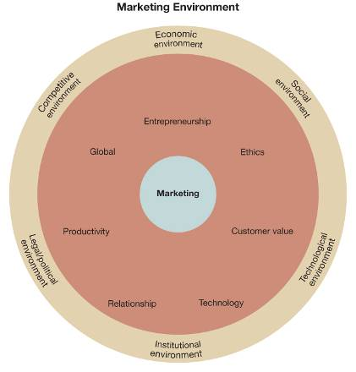
The Marketing Environment
The marketing environment consists of all factors external to an organization that can affect the organization’s marketing activities.
Exhibit 2-1

Slide 38
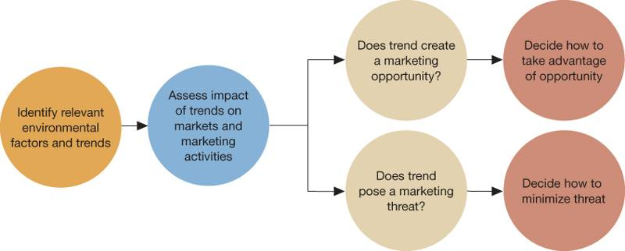
Identifying Market Opportunities and Threats
Many firms use environmental scanning to identify important trends and determine whether they represent present or future market opportunities or threats.
Exhibit 2-2

Slide 39
The Social Environment
The social environment includes all factors and trends related to groups of people, including their number, characteristics, behavior, and growth projections.
Number of
People
Social
Environment
Growth
Projection
Characteristics
Behavior

Slide 40
The Demographic Environment
The demographic environment refers to the size, distribution, and growth rate of groups of people with different characteristics.
The demographic characteristics of interest to marketers relate in some way to purchasing behavior, because people from different countries, cultures, age groups, or household arrangements often exhibit different purchasing behaviors.
A global perspective requires that marketers be familiar with important demographic trends around the world as well as within the United States.

Slide 41
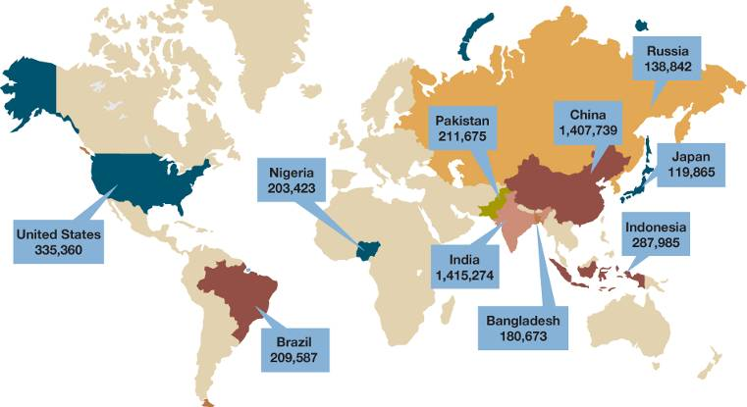
Population Estimate —Year 2025
Exhibit 2-3

Slide 42
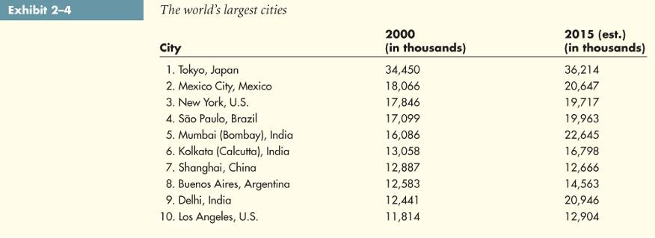
Demographic Trends
World and country population statistics are important, but most marketers target subgroups. Trends in population subgroups are typically the most useful to marketers, for example, the growth of the urban population.

Slide 43
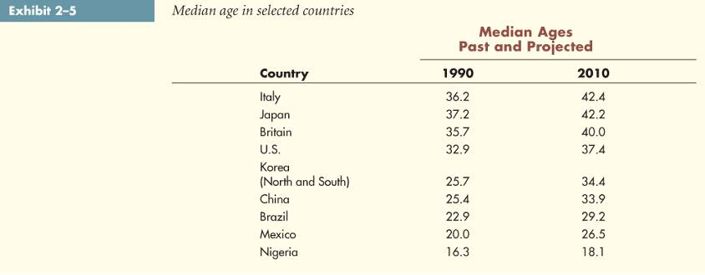
Demographic Trends
Another interesting trend is the aging of the population. The aging of the population is especially evident in Italy, Japan, Britain, and the United States.

Slide 44
The Cultural Environment
The cultural environment refers to factors and trends related to how people live and behave.
Values
Cultural
Factors
Subgroup
Activities
Ideas
Beliefs
Attitudes

Slide 45
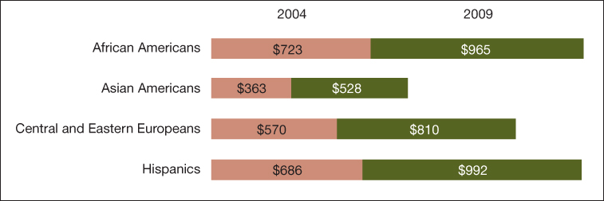
Cultural Diversity
Cultural differences are important in both international and domestic markets.
Much of the population and buying power growth in the United States is and will be from multicultural groups.
Exhibit 2-6

Slide 46

Changing Roles
As more women enter the workforce and household compositions change, typical household roles are altered.
Tremendous market opportunities exist for firms that can develop effective strategies for appealing to these changing roles.

Slide 47
Emphasis on Health & Fitness
The pursuit of a more healthful lifestyle includes:
eating more nutritious foods
exercising regularly
participating in various sports activities
focusing on wellness.
This translates into potential market opportunities for firms that provide products and services geared toward improving health and fitness.

Slide 48
The Desire for Convenience
Increased desire for convenience created by:
Changes in household composition
Increases in the number of working women
General shortage of time

Slide 49
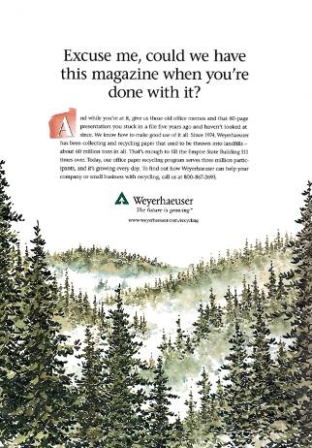
Consumerism
Consumerism is the movement to establish and protect the rights of buyers.
One increasingly important consumer issue is environmentalism.
Successful marketers can respond by developing environmentally safe products and communicating their environmental contributions.

Slide 50
The Economic Environment
The economic environment includes factors and trends related to income levels and the production of goods and services.
Economic trends in different parts of the world can affect marketing activities in other parts of the world.
The gross domestic product (GDP) represents the total size of a country’s economy measured in the amount of goods and services produced.

Slide 51
The Political/Legal Environment
The political/legal environment encompasses factors and trends related to governmental activities and specific laws and regulations that affect marketing practice.
Global
Trends
Political
Legal
Environment
Regulation
Legislation

Slide 52
Global Political Trends
In today’s world economy, international political events greatly affect marketing activities. For example the impact of the war on terrorism on the travel and security industries.
A second important political trend is movement toward free trade and away from protectionism. Studies show that countries with the freest trade have the highest GDP growth.

Slide 53
The Technological Environment
The technological environment includes factors and trends related to innovations that affect the development of new products or the marketing process.
These technological trends can provide opportunities for new product development, affect how marketing activities are performed, or both.

Slide 54
The Competitive Environment
The competitive environment consists of all the organizations that attempt to serve similar customers.
Brand Competitors
The most direct competition, offering the same types of products as competing firms. For example, Nike is a brand competitor of Reebok as both companies manufacture shoes.
Product Competitors
Offer different types of products to satisfy the same general need. Domino’s Pizza, McDonald’s, and Kentucky Fried Chicken are product competitors.

Slide 55
The Institutional Environment
The institutional environment consists of all the organizations involved in marketing products and services.
Market Research Firms
Retailers
Advertising
Suppliers
Wholesalers
Customers

Slide 56
The Future
The only certainty about the future is that it will be uncertain, and change will occur at an increasing rate.
It will also be more complex.
Businesses and consumers now must operate in an era of terrorism and lack of trust.

Slide 57
EPRG Framework

Slide 58


Different attitudes towards company’s involvement in
international international
marketing process are marketing orientations.
called EPRG
framework was introduced by Wind, Douglas and
Perlmutter.
This framework addresses the way strategic decisions are made and how the relationship between headquarters and its subsidiaries is shaped.

Slide 59
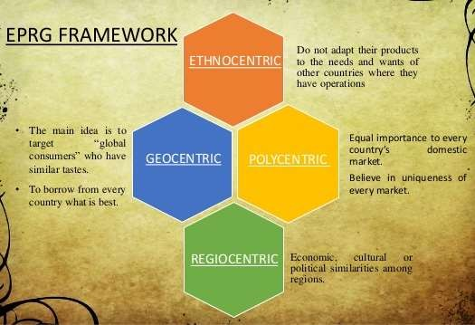

Slide 60
Management orientation – Home country orientation
Characteristics –
Overseas operations viewed
as secondary
& primary
means of
disposing the surplus production
Domestic techniques & personnel superior to foreign & most effective in overseas market
Domestic marketing mix is employed without major modifications in overseas market
All foreign marketing operations are planned & carried out from home base & overseas marketing administered by export department

Slide 61
Marketing strategy – Extension of domestic strategy to foreign market
Companies’ basic objective – Profitability
Type of governance – Top-down Culture - Home country Technology - Mass production
HRM practices – Overseas operations are managed by
people from home country
Managerial predisposition - Manager/MNC rely on values & interests of parent company in formulating and implementing strategic plan

Slide 62

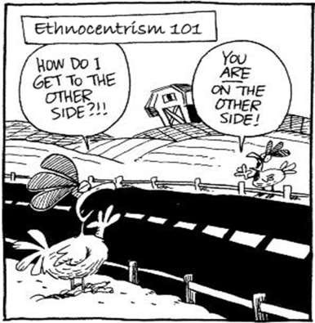
Merits –
No cost & efforts needed for adaptation/localization
It is an easy route to internationalization when foreign market exists with similar domestic characteristics
Demerits –
No full exploitation of IB
opportunities worldwide
Main focus on domestic market

Slide 63

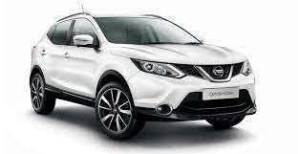

Nissan’s ethnocentric orientation was quite apparent during its first years of exporting cars and trucks in United States. Designed for mid Japanese winters, the vehicles were difficult to start in many parts of the US during the cold winter months. In northern Japan many car owners would put blankets over their hoods of their cars and they expected Americans would do the same.

Slide 64
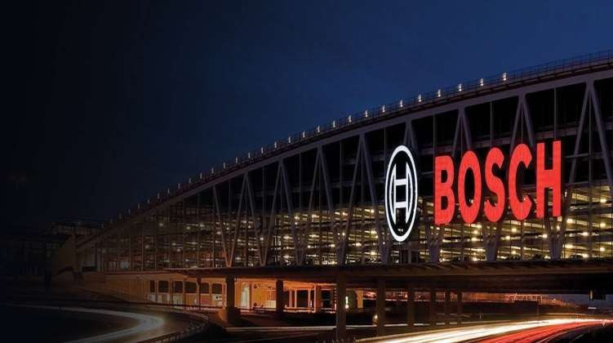
Robert Bosch GmbH, or Bosch, is a German multinational engineering and electronics company headquartered in Gerlingen, near Stuttgart, Germany. It is the world's largest supplier of automotive components measured by 2011 revenues,
It proudly believes in German engineering and promotes its products with same approach.

Slide 65
Surf Super Washout in Japan
Unilever enters Japan Detergent Market
It releases Surf Super concentrate washing powder in Japan
Measured sachets for Convenience.
Fresh Smell
WHAT WENT WRONG??

Slide 66
Washing powder did not dissolve completely due to weather conditions
Low agitation washing machines were more popular in Japan, in which the super concentrate surf washing powder did not wash completely.
Fresh smell was not very significant

Slide 67
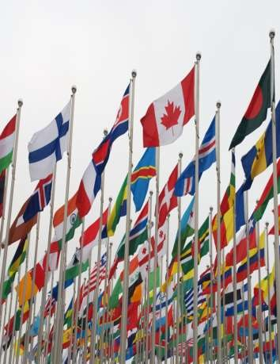
POLYCENTRIC
Management orientation – Host country orientation
Perception about market –
Each national market is distinctive
Focuses on differences between home
country & foreign country
Marketing strategy – Localization / adaptation
Companies’ basic objective – Public acceptance

Slide 68
Type of governance – Each local unit sets objectives (bottom up)
Culture- Host country
Technology - Batch production
HRM practices – Local nationals are used in key management positions
Managerial predisposition - MNC tailor strategic plan to meet
the need of local culture

Slide 69
Characteristics –
Recognize importance of inherent differences in overseas markets
Subsidiaries are established in overseas market & each is independent with own marketing objectives & plans
Local techniques & personnel best suited to deal with local market conditions
International marketing organized on country to country basis with separate marketing strategy for all

Slide 70

Merits –
Adaptation to market characteristics help in better understanding of local needs which will lead to better exploitation of market potentials
Demerits –
High cost of national responsive marketing mix for each country
Delay in localization

Slide 71

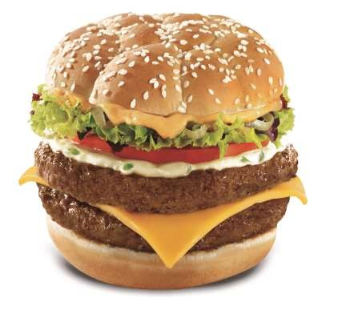
McDonald’s
McDonald’s strategy to serve veg burgers in India instead of non- veg burgers (pork and beef) to its Indian customers can be termed as polycentric.

Slide 72

Gerber
When Gerber, a Nestle owned purveyor of baby foods first started selling their baby food in Africa, they used the same packaging as in the USA – with the cute baby on the label. Later they found out that in Africa companies routinely put pictures on the label of what is inside the package, since most people cannot read.

Slide 73
REGIOCENTRIC
Regiocentrism is a transitional phase between polycentric and geocentric orientation.
Firm accepts a regional marketing policy covering a group of
countries which have comparable market characteristics.
Operational strategies are formulated on the basis of the entire
region rather than individual countries.
The company views the similarities and differences between regions.

Slide 74

REASONS FOR MAKING USE OF A
REGIOCENTRIC APPROACH
Facilitates the interaction taking place between local national executives transferred from operations in the region to regional head office, and executives transferred from the parent company to the regional headquarters.
Shows some level of sensitivity towards local conditions in the host-country
Can be utilized as a transitional step where the multinational organization wishes to develop from a purely ethnocentric or polycentric approach to a geocentric approach

Slide 75
ADVANTAGES | DISADVANTAGES
Culture fit | Lack of Understanding between managers at various levels
Less cost is incurred in hiring the natives of the host country. | There could be a communication barrier
The managers work well in all the neighboring countries within the geographic region of the business | Lack of International Experience.
The nationals of host country can better influence the decision of managers at headquarters with respect to the entire region. | It may lead to the confusion between the regional objectives and the global objectives

Slide 76
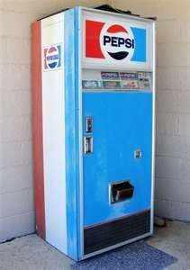

PEPSI Vs. COKE
In the 1950s, Pepsi reportedly lost its dominant share of the beverage market in at least one southeast Asian country after changing its vending machines and coolers from a deep regal blue to light ice blue. Light blue is associated with death
in that region, and Pepsi’s subsequent loss was competitor Coca-Cola’s gain.

Slide 77
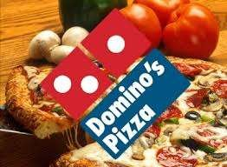
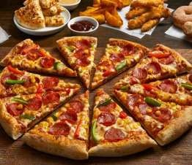
MARKETING EXECELLENCE
Domino’s has a regional approach to serve pizzas which has made it a much bigger brand than its rivals.
The company introduced its American Legends line of specialty pizzas in 2009, featuring 40% more cheese than the company's regular pizzas, along with a greater variety of toppings
In 2010, shortly after the company's 50th anniversary, Domino's changed its pizza recipe "from the crust up", making significant changes in the dough, sauce, and cheese used in their pizzas
In December 2013, Domino's Pizza, in Israel, unveiled its first vegan pizza, which uses a soy-based cheese substitute
In 2014, Domino's Pizza in Nigeria introduced the new Jollof Rice Pizza and The Beef Stew Pizza

Slide 78
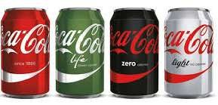


“Coca-Cola Zero provides real Coca-Cola taste for variety-seeking consumers. Coca-Cola Zero is sweetened with a blend of low-calorie sweeteners, while Diet Coke is sweetened with aspartame. As for Coke/Coca-Cola light, in certain
countries, the term ‘diet’ is not used to describe low-calorie foods and beverages. In these countries, we offer Coke/Coca-Cola light. The sweetener blend used for Coke/Coca-Cola light is formulated for each country based on consumer preference

Slide 79





MTV has catered to local taste in East Asia in South Korea, China, India and Japan. E.g. MTV broadcasts on two channels with Chinese music in China and Hindi pop in India.
Using joint ventures with local partners, channels are branded accordingly as MTV India, MTV Korea, MTV China and MTV Japan and use more local employees with use of local language.

Slide 80


CENTRIC

Slide 81
GEOCENTRIC
The geocentric orientation represents a synthesis of ethnocentrism and polycentricism into a ‘world view’ that sees similarities and differences in markets and countries, and seeks to create a global strategy that is fully responsive to local needs and wants.
It displays the “think global, act local” ideology.

Slide 82
Standardization or Adaption?
Standardization
Assumes homogenous markets and in response offers standardized products and services using a standardized marketing mix
Adaption
Takes into account the inherent diversity in the global marketplace and adapts the marketing mix to fit the local culture, preferences, laws and rules, infrastructure and competition

Slide 83
REALITY
Companies that operate in foreign markets should have eclectic abilities to seek integration, sensitivity and learning on the global scale at the same time, and standardization and adaption should not be evaluated as approaches that cannot be coordinated.

Slide 84

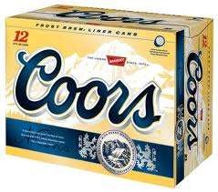
Workers in an African port saw the “Fragile” symbol and presumed it was broken glass, threw it all in the sea
‘Turn It Loose’ Slogan
Translated into Spanish, it read "Suffer From Diarrhea."

Slide 85

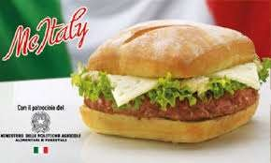


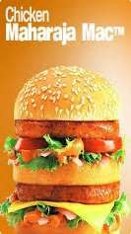
McDonald’s offers beer in Germany, wine in France, mutton pies in Australia, Veggie McNuggets in India, Teriyaki Burger in Japan, McLaks in Norway
Some if its local favorites around the world include the McItaly burger in Italy, Maharaja Mac in India, the McLobster in Canada, the Ebi Filit-O in Japan

Slide 86



Slide 87
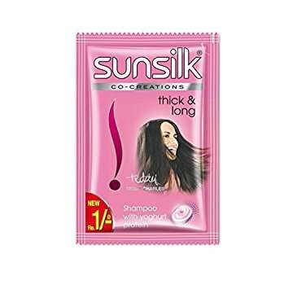
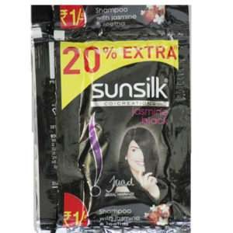

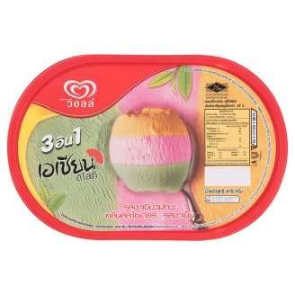

HLL identified the importance of rural customers and invented the shampoo sachets priced at almost a rupee which were an instant hit.
Asian Delight (Thailand)

Slide 88
CONCLUSION
As brands go international—in some cases as we have seen above—brand managers can forget that simple truth. That is, know your market. Cross cultural marketing is simply about using common sense and analysing how the different elements of a brand are impacted by culture and modifying them to best speak to their target audience.
Many international companies have had problems with expanding their brands worldwide because they have failed to put in the research and effort necessary to understand the culture. This has lead to several failed brands, to offended consumers, and to the loss of millions of dollars that comes with having to start all over again.

